Slide 1
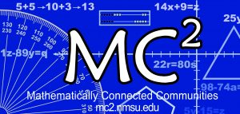
Mathematically Connected Communities
This session will be recorded and available at https://mc2.nmsu.edu/
Welcome! Please introduce yourself in the chat box by writing your name, your district, and your role in the education sector.
The Importance of Models in Developing Fluency
September 23, 2020
5:00-6:00 pm

Slide 2
Check In
What’s the last movie you watched/show you binge-watched?
What have you learned about yourself and others in quarantine?
What are you leaving behind from your pre-CoronaVirus life?

Slide 3
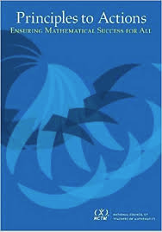
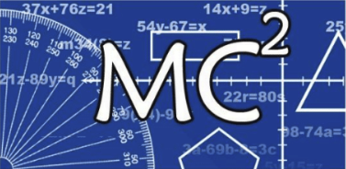
Mathematically Connected Communities (MC²) works to improve math education through a variety of professional learning experiences which align to the New Mexico Public Education Department’s (NM PED) reentry guidance.
Four Live Web-Events Sessions
Awareness and Information: Purposeful Reentry and Adapting to Change
Unpacking Important Mathematics Reentry Documents
Structuring Accelerated Learning in Reentry
The Importance of Models in Developing Fluency

Slide 4
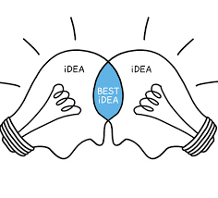
Norm Offerings for our Collaborative Session
In exploring today, what are the norm(s) you will take with you?
Invite participation by using names
Honor individual thinking and learning time
Ask questions
Expect to share
Reflect on where you want to grow
Other?

Slide 5
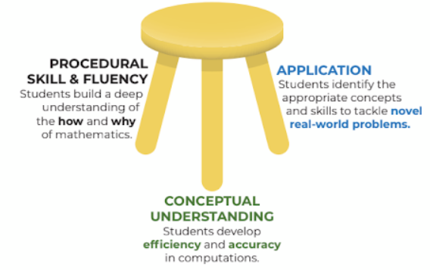
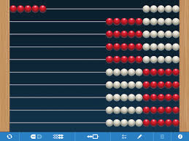
Session Goal: Why Models and Fluency?
9 + 6…
9, 10-11-12-13-14-15
“…the most commonly observed characteristic of low attaining math students is a persistent dependence on counting by ones.”
-Wright et. al., 2012

Slide 6
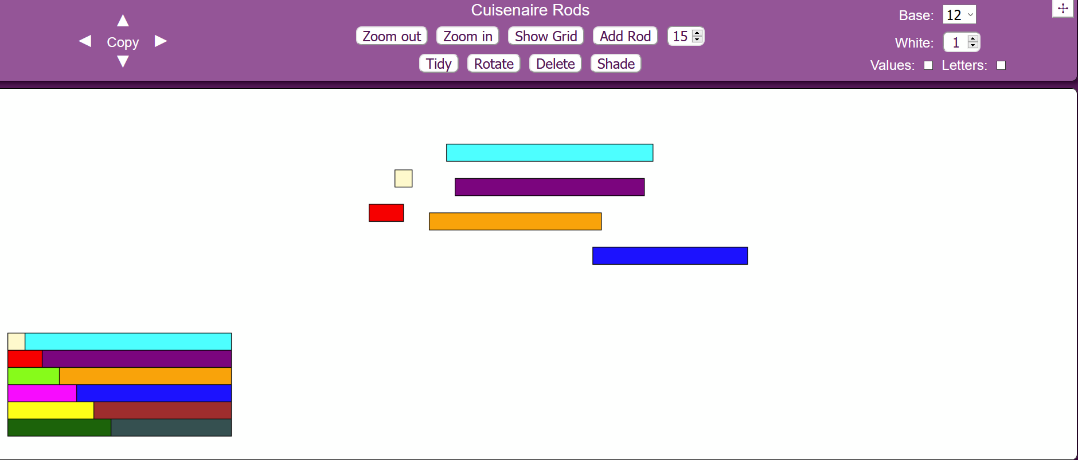
Guess My Fraction
Cuisenaire Rods

Slide 7
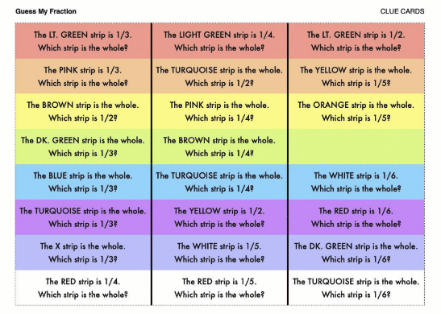
Let’s play with the tool first! Explore the settings. What noticings do you have? What are some tasks your students could engage in?
In the upper right corner of the webpage, adjust the base to 12.
Put one of each color in your workspace. You will have 12 bars. Do not add additional bars to your set. Use your set of cuisenaire rods to solve the task.
Let’s look at 1 or 2 of the rows of the Guess My Fraction clue card and the cuisenaire rods to explore it.

Slide 8
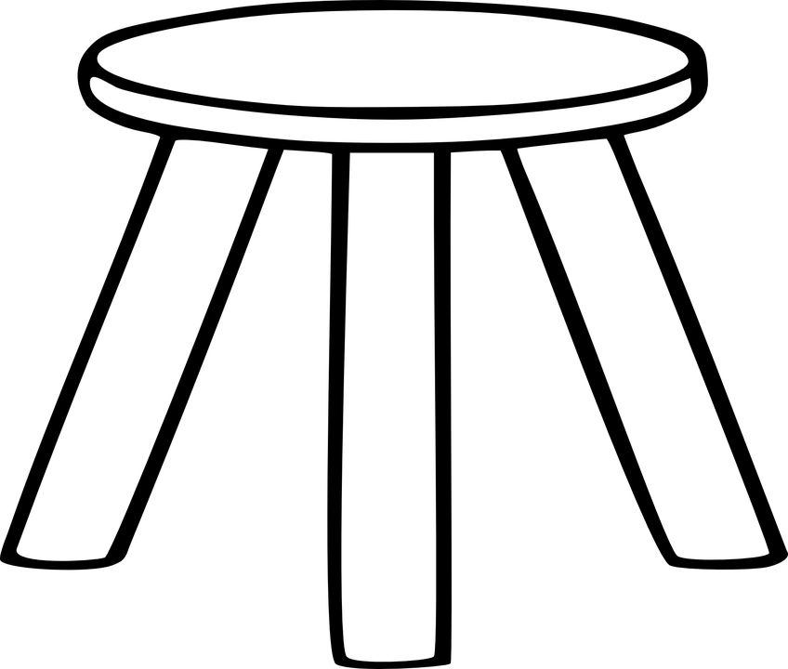
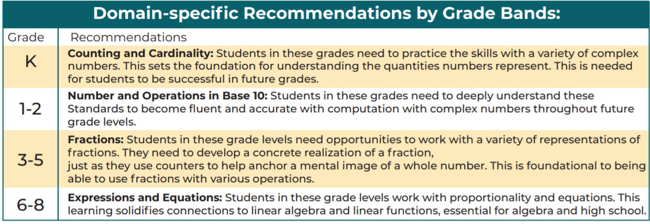
Fluency
When Mathematical skills grow from conceptual understanding, students can use the relational knowledge in application and computation.

Slide 9
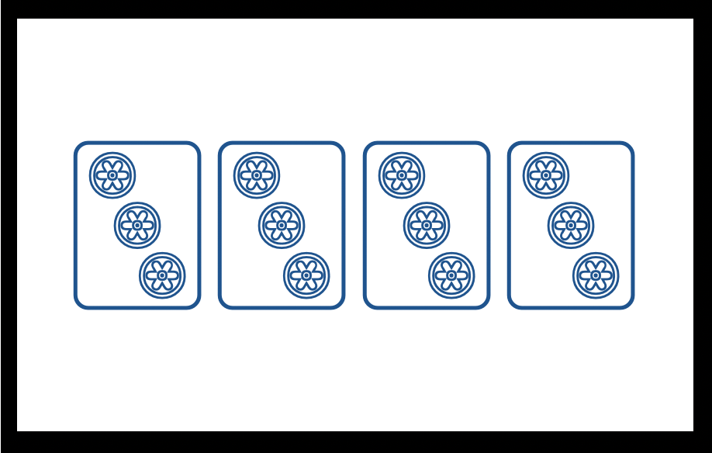
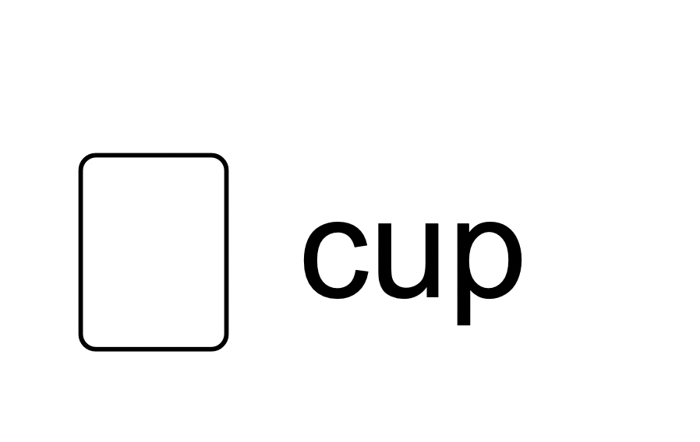
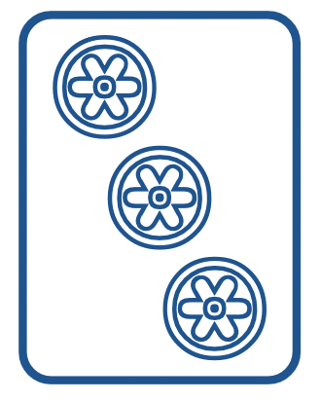
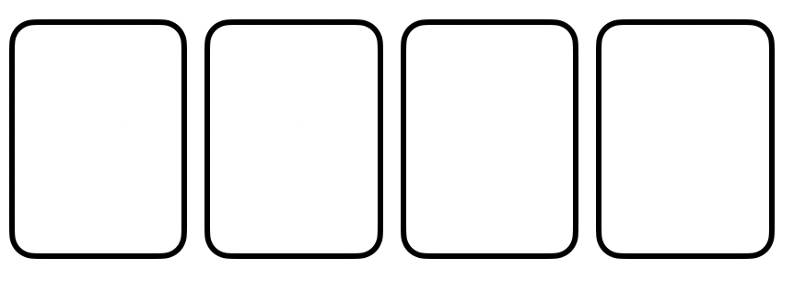
2 ¢
Discussion Card
3
chips
4
cups
Support Card:
cups in a box
Support Card:
chips in a cup
? ¢

Slide 10
4 ¢
Discussion Card
4
chips
64 ¢
Support Card:
cups in a box
Support Card:
chips in a cup
?
cups

Slide 11
Reflect: What do you know now that you would share with a colleague? What have you learned that excites you about planning for students’ mathematics learning?

Slide 12
Thank you!
Thank you for being a part of this Purposeful ReEntry Community!
Thank you for all you do for children and the larger community through your work.
Keep on swimming!
Link to MC² Website:
https://mc2.nmsu.edu/
Link to MC² Professional Learning Page: https://mc2.nmsu.edu/pd/
Link to MC² Contact Page: https://mc2.nmsu.edu/about-us/contact-us/

